Slide 1
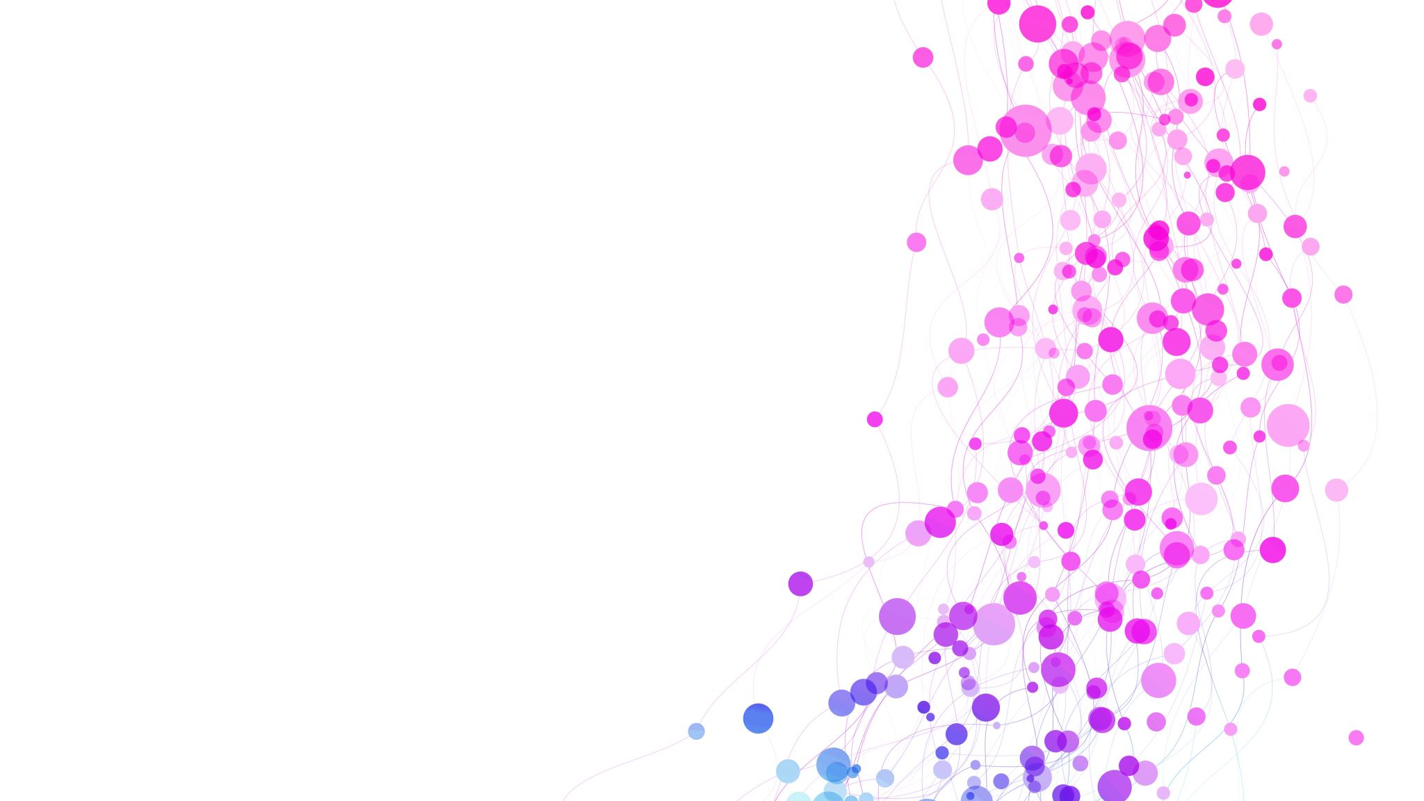
EDA Case Study
PROBLEM STATEMENT
In our EDA case study we are focused on analysing the conditions while
financial loan application approval.when a loan giving firm receive a
Loan application he had decide based on various factor to whether to
Approve a loan application or reject it
There are two condition on which loan giving firm focused on:-
Customer capable of repaying the loan are not get rejected
by the firm because it can lead to INTEREST LOSS.
Secondly, that are not cabable of repaying the loan should
not get approved because that can lead to CREDIT LOSS
So, through the EDA process we will analyse data sets to summarise with
their ,ain characteristics with visual methods.

Slide 2
Load the data & see the structure of data
STEP 1 - Load the both given data set (in excel form) that are APPLICATION & PREVIOUS APPLICATION data set by using the .csv extension.
STEP 2- After loading the data set check the STRUCTURE of the data set(normal routine check)
Like .info, describe, d types, columns , missing values etc.

Slide 3
DATA QUALITY CHECK AND MISSING VALUES
Find the PERCENTAGE of missing values for all the columns.
Remove the columns with high percentage of missing values because it can lead up to the analyses
to the wrong path.(adversely effect the final result)
Drop all the irrelevant columns that are not much useful considering the problem statement.
Impute the missing the values in all the remaining columns like:
If the column is categorical then the imputation of the mode is considered as the best option
If the column is continuous column it can be imputed with median (after checking the outliers)
Check for the duplicates values and remove them

Slide 4
Removing the null values
Removing the null values in AMT_ANNUITY & AMT_GOODS_PRICE columns by dropping the all null values containing it since it is few in quantity(does not effect the overall data)
Replacing null values NAME_TYPE_SUITE & NAME_TYPE_SUITE_mode column by the mode of the column because it is a categorical column so check for percentages of all values and replace by the highest percentage value

Slide 5
Data cleaning & manipulation
This steps include checking for DATA QUALITY issues and binning of continuous variables
Changing all the columns into their desired datatypes like converting the AMT_INCOME_TOTAL,AMT_CREDIT’,AMT_ANNUITY’ etc into int format from the float format.
Converting the all those columns containing the two values into single value like Secondary / secondary special unto only ‘secondary’
Similar changing all the negative values into positive values in days columns since days cannot be negative.
Checking for the outliers in all columns and capping it to certain limits.

Slide 6
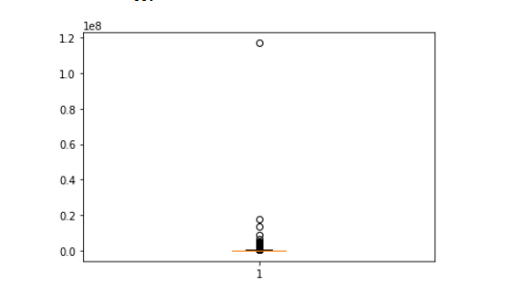
OUTlier example:

Slide 7
Binning :
Binning all the continuous variables like all the columns containing the ‘amount values’ into the labels using the quantile ranges like income into low, medium and high category.
Similarly binning the categorical variables like ages, employment type, education type etc.

Slide 8
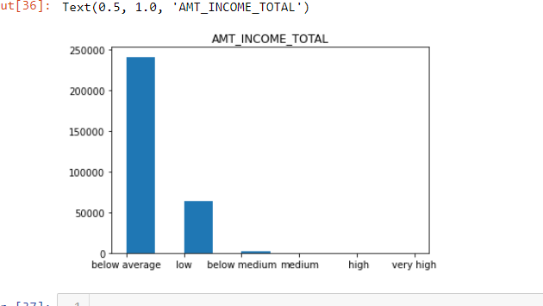
Binning Example

Slide 9
data analysis :-
Firstly we have to check for the data imbalance regarding the TARGET VARIABLE after checking the target variable approx. 92 % are ‘deflauters and only 8% are ‘non- defaulters.
Now we have to do various analysis like Univariate analysis and bivariate analysis for this analysis we have made two data frames on basis of TARGET variable namely appdata_0 for non defaulters and appdata_1 for defaulters , defaulters are one who do not pay there loan on time
After making two different data frames we have to do different analysis

Slide 10
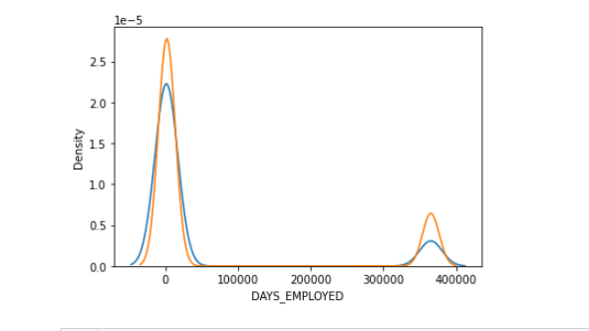
Example of univariate analysis

Slide 11
.
The above analysis shows that most defaulters lie in the range of less days employed and many other analysis also shows that there are many ways to show that income also varies and amount annuity also varies for the defaulters and non defaulters
We have done univariate analysis both on categorical and continuous variable you can see in the file attached

Slide 12
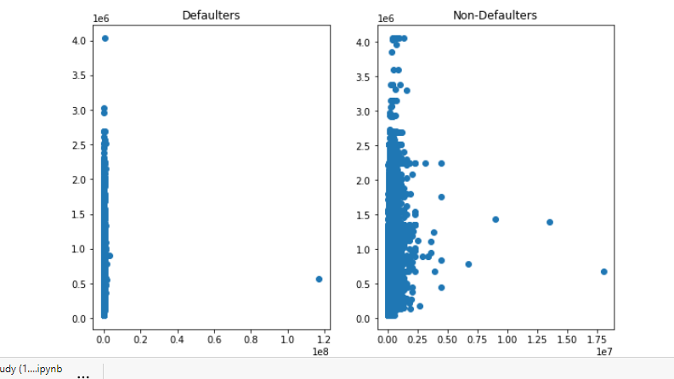
EXAMple of Bivariate analysis

Slide 13
.
The above is an example of bivariate analysis in which we have done analysis on income vs credited loan amount and it is clearly visible that defaulters have less credits and non defaulters are having high credits
Bivariate Analysis have been done on following data:
1.Categorical-Continuous
2.Continuous-Continuous
3.Categorical-Categorical

Slide 14
Finding the correlation among all the numerical variable with target 1
By Using the heatmap we can see there is least correlation between the credit,annutity,good price variable and the INCOME variable.
Similarly there is strong between annuity and credit,credit and good price,good price and annuity
similarly we can perform same analysis with the target 0 and observe the trend in all numerical columns

Slide 15
Categorical analysis
Defaulters have the larger no. of cars as compared with the non defaulters
Defaulters have less no.of realty as compared with the non defaulters
Defaulters basically belongs to secondary education but non defaulters belongs to high education
As the inferences married people more belongs to defaulters .

Slide 16
Adding the previous application file
Read the .csv file of the ‘ previous aaplication’
Check for the null values abd remove the columns with more than 40% percent NULL values
Drop all the XNA,XAP values and check for the outliars
Then merge the previous application file with the application file sid eby side and only 30 of the previous application file rows.
Atlast perform the univariate analysis with the ‘finaldata’ dataframe

